Slide 1
QCD meets experiment
June 12 - June 20, 2014 Zakopane, Poland
Peter Braun-Munzinger (GSI, Darmstadt)
Wojtek Florkowski (Inst. of Nucl. Phys. Polish Academy of Sciences, Krakow and Jan Kochanowski University, Kielce)
Marek Gazdzicki (Goethe University, Frankfurt and Jan Kochanowski University, Kielce)
Christian Hoelbling (Wuppertal University)
Adam Kisiel (Warsaw University of Technology)
Yuri Kovchegov (The Ohio State University)
Larry McLerran (Brookhaven Nat. Lab. and RIKEN and CCNU, Wuhan, China)
George Sterman (Stony Brook University)
Michael Strickland (Kent State University)
Urs Wiedemann (CERN)

Slide 2
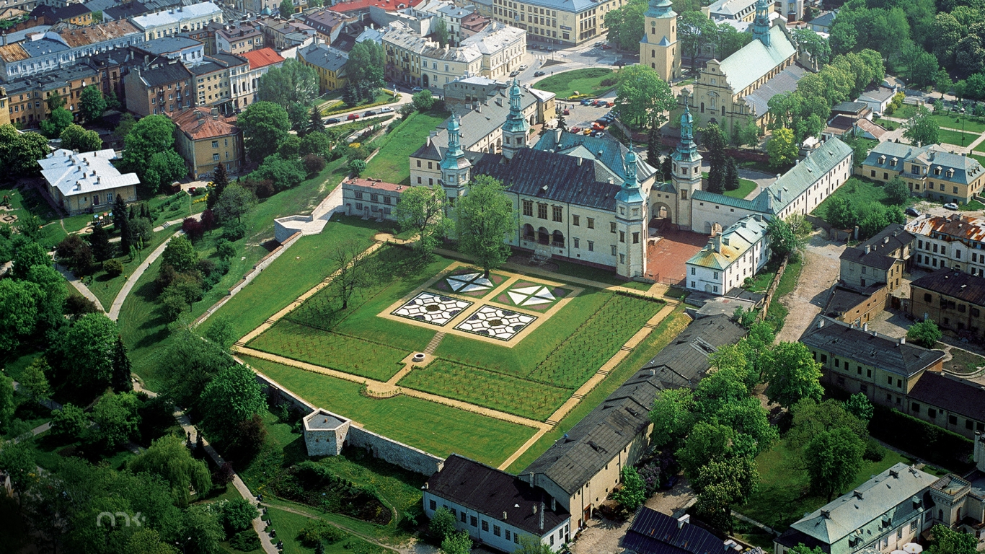
Geometrical scaling in hadronic collisions
Michał Praszałowicz
Jagiellonian University
Kraków, Poland
10-th Polish Workshop on Relativistic Heavy-Ion Collisions, December 13-15, 2013
Institute of Physics, Jan Kochanowski University, Kielce

Slide 3
Geometrical Scaling
J. Dias de Deus, Nucl. Phys. B 59 (1973) 231;
A.J. Buras, J. Dias de Deus, Nucl.Phys. B 71 (1974) 481;
J. Dias de Deus, P. Kroll, J. Phys. G 9 (1983) L81;
J. Dias de Deus, Acta Phys. Polon. B 6 (1975) 613.
Geometric scaling for the total γ* p cross-section in the low x region. A.M. Stasto, K. J. Golec-Biernat , J. Kwiecinski PRL 86 (2001) 596-599
M. P. and T. Stebel JHEP (2013) 1303 090, 1304 169
L. McLerran, M. P. Acta Phys.Polon.B41:1917,2010, B42:99,2011
M. P. Phys.Rev.Lett.106:142002,2011, Acta Phys.Pol. B42 (2011) 1557-1566
Phys.Rev. D87 (2013) 071502(R)
L. McLerran, M.P. and B. Schenke, arXiv:1306.2350 [hep-ph] (Nucl. Phys. A)

Slide 4
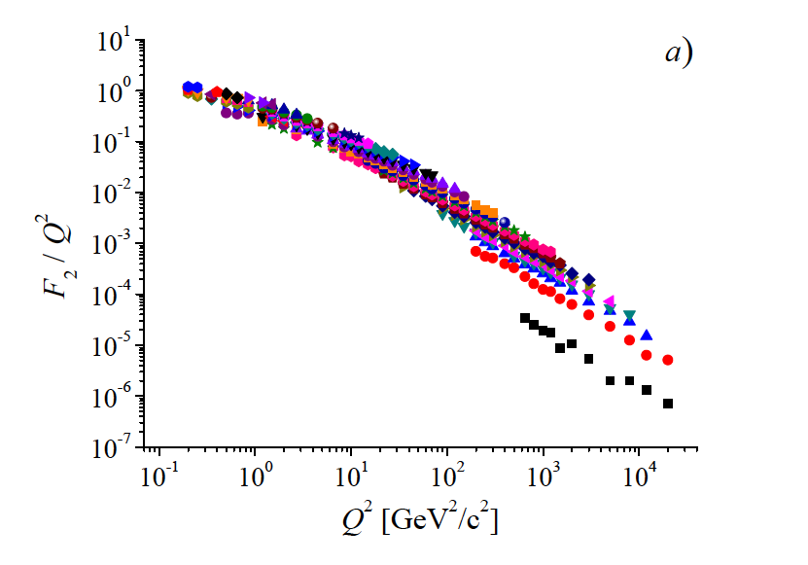
Combined HERA data 2009 for e⁺

Slide 5
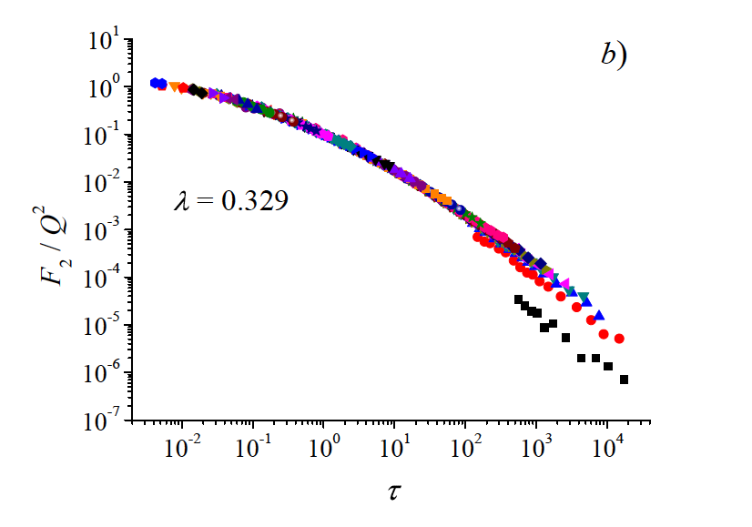
large x

Slide 6
Domain of GS in DIS
λ = 0.329 ± 0.005
up to x = 0.08 (!)
M. P. and T. Stebel JHEP (2013) 1303 090, 1304 169

Slide 7
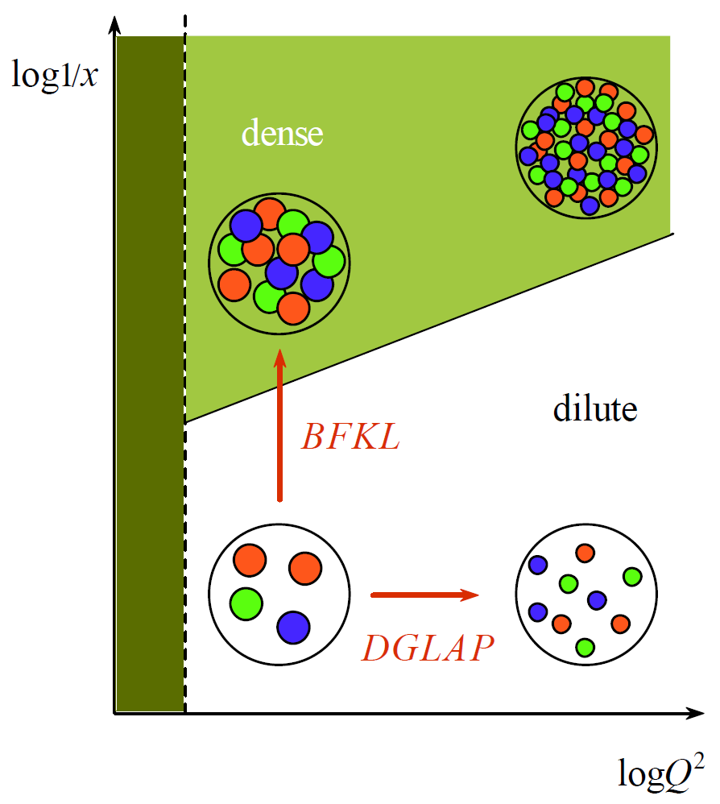
Saturation
small x
large W
large x
small W
© E.Iancu

Slide 8
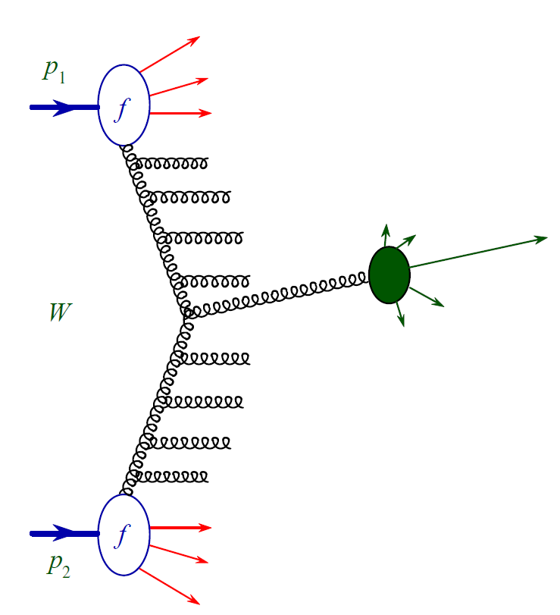
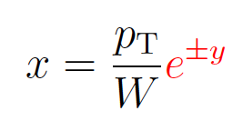
p-p at the LHC

Slide 9
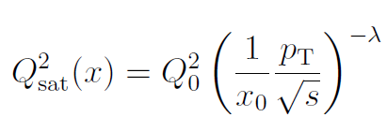
Geometrical scaling of p_{T} distributions
multiplicity distribution
is a universal function
of scaling variable τ
note that for λ = 0 scaling variable τ = p_{T}²

Slide 10
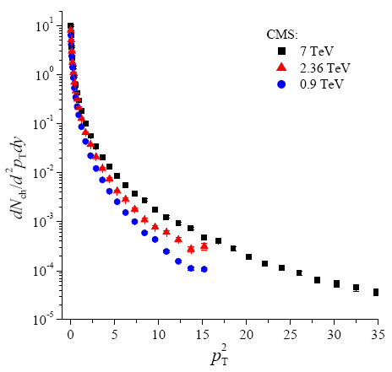
Geometrical scaling of p_{T} distributions

Slide 11
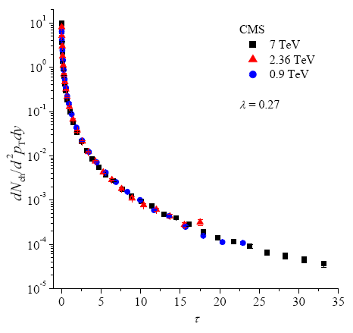
Geometrical scaling of p_{T} distributions

Slide 12
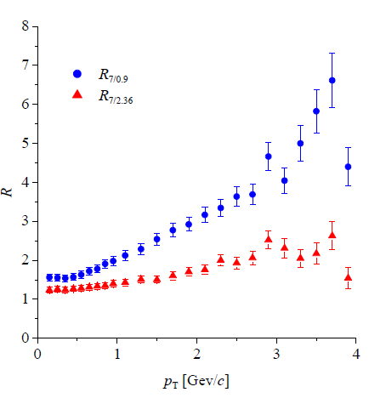
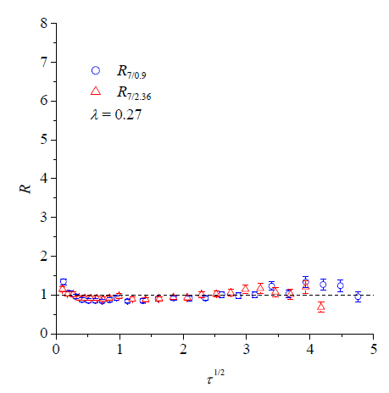
Ratios of p_{T} spectra
quality of GS can be examined by looking at the ratios:

Slide 13
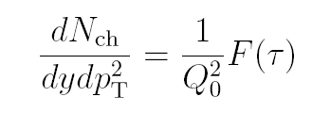
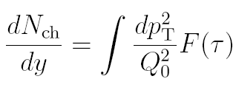
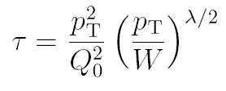
Geometrical scaling of p_{T} distributions

Slide 14
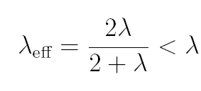
Geometrical scaling of p_{T} distributions
integral over dτ
is energy
independent
effective growth
of multiplicity is
slower than λ

Slide 15
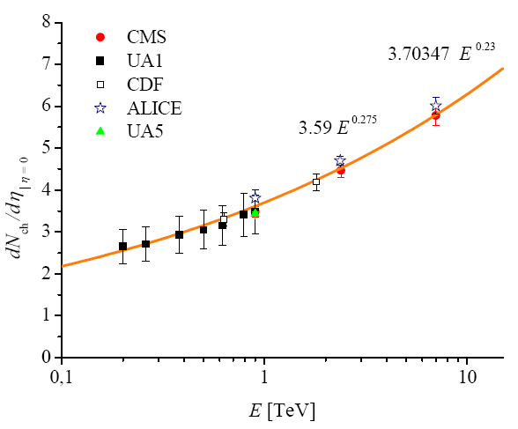
Multiplicity from GS

Slide 16
p-p at forward rapidity y > 0

Slide 17
Kinematical range of GS in pp

Slide 18
Kinematical range of GS in pp
transverse momentum schould be larger
than some nonperturbative scale Λ

Slide 19
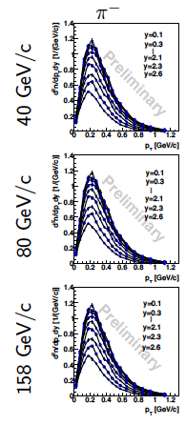
NA61 Shine data

Slide 20
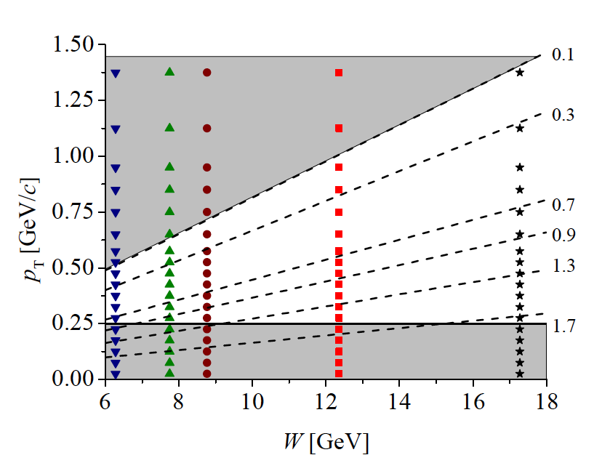
NA61 kinematical range

Slide 21
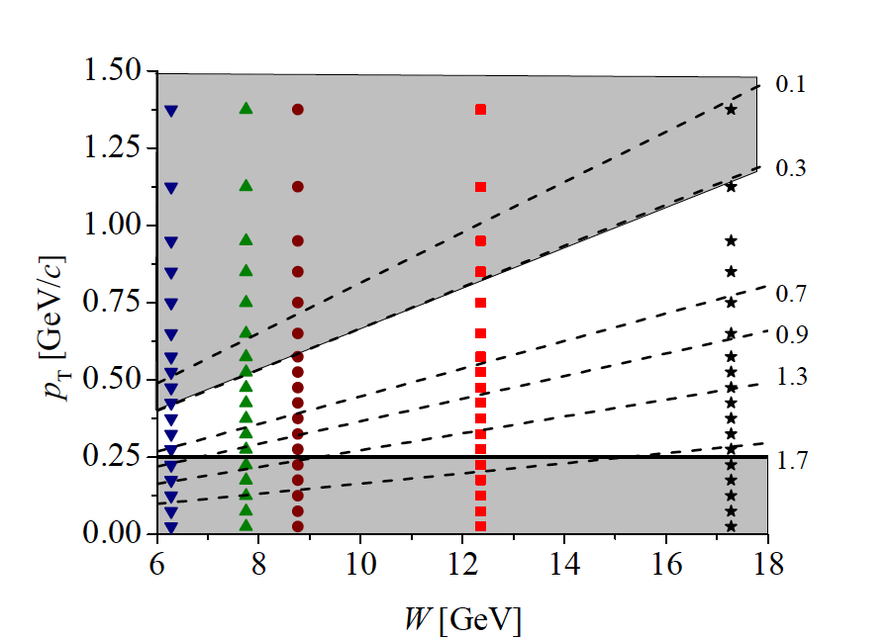
NA61 kinematical range

Slide 22
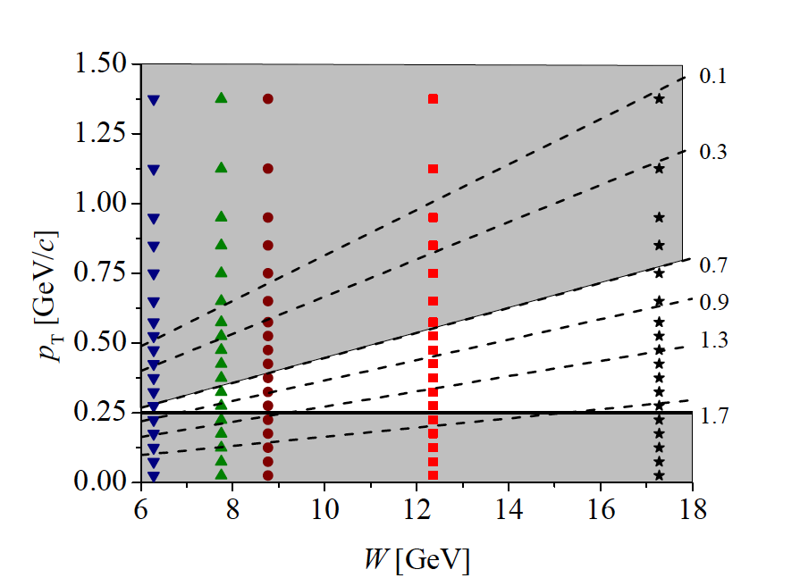
NA61 kinematical range

Slide 23
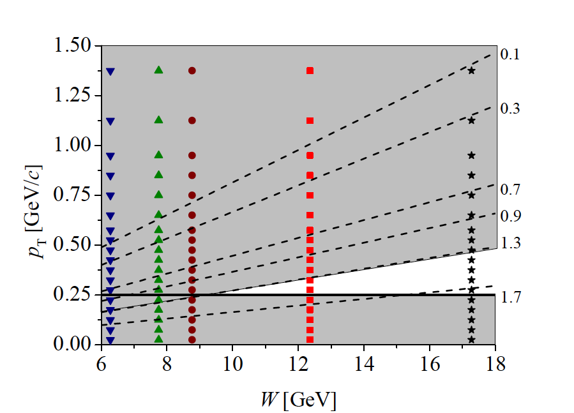
NA61 kinematical range

Slide 24
6.28
7.75
8.77
12.36

Slide 25
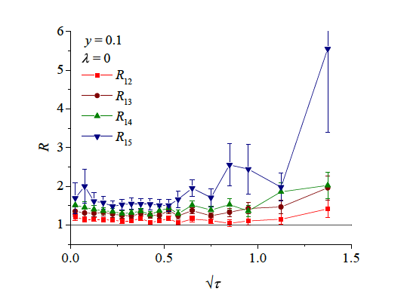

Slide 26
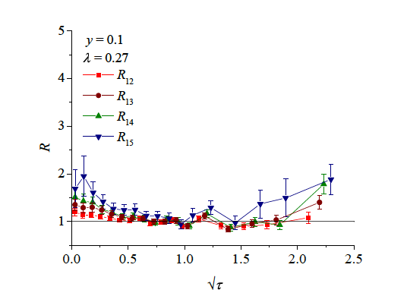

Slide 27
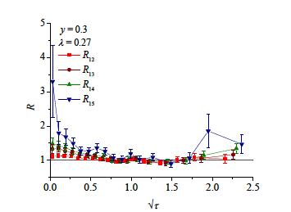
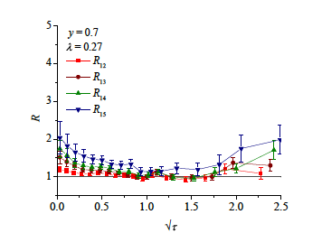
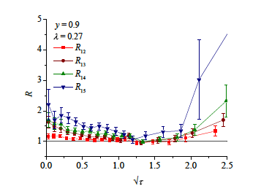
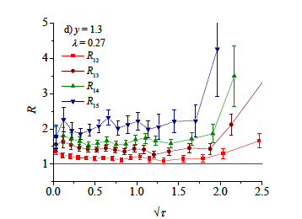

Slide 28
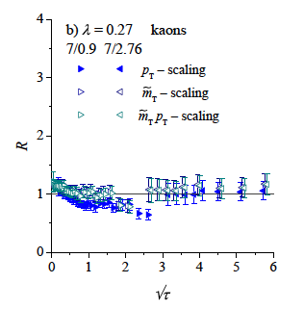
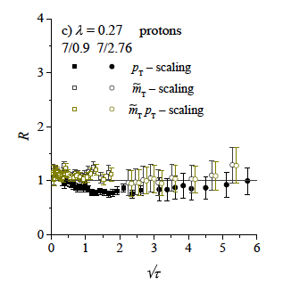
GS for identified particles

Slide 29
Summary
GS in DIS works for rather high Bjorken x
GS works also for charge particles in pp
GSV is found for y ≠ 0 in agreement with expectations
GS for identified particles in m_{T} − m
Why does this work?
Universal shape of GS
connection with Tsallis-like parametrization
relation to unitegrated glue
GS in HI
A dependence of the saturation scale
centrality dependence
why pp lambda is different than in DIS?
quantitative analysis is needed

Slide 30
Summary
GS in DIS works for rather high Bjorken x
GS works also for charge particles in pp
GSV is found for y ≠ 0 in agreement with expectations
GS for identified particles in m_{T} − m
Universal shape of GS
connection with Tsallis-like parametrization
relation to unitegrated glue
GS in HI
A dependence of the saturation scale
centrality dependence
why pp lambda is different than in DIS?
quantitative analysis is needed

Slide 31
Backup Slides

Slide 32
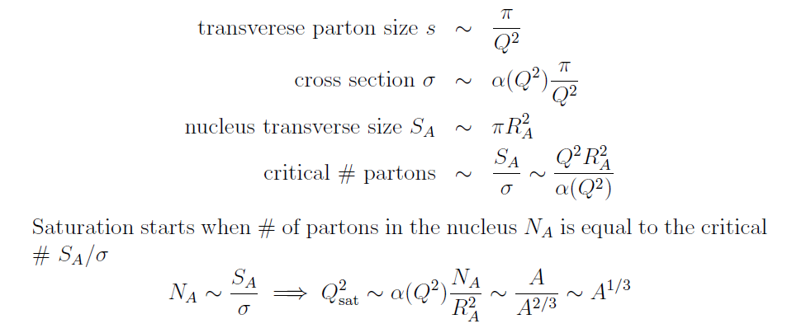
GS in HI: A dependence

Slide 33
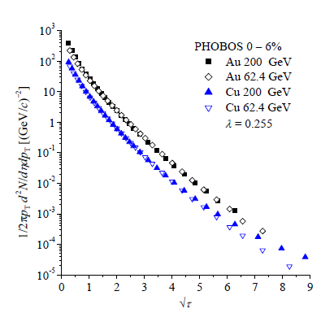
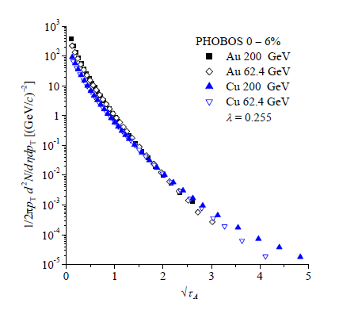
GS in HI: A dependence

Slide 34
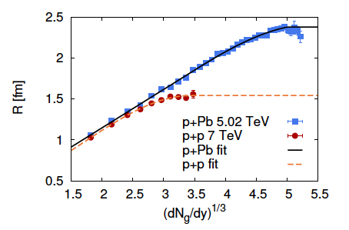
GS in pA
_

Slide 35
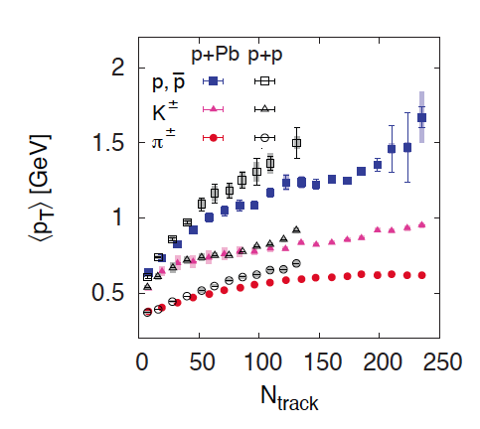
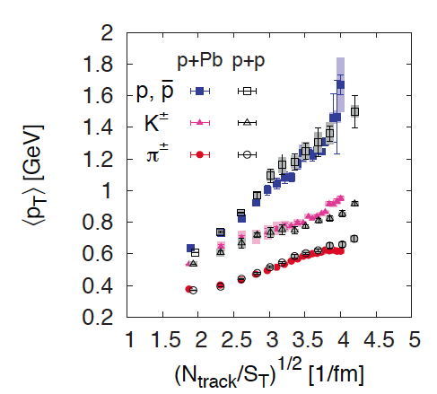
GS in pA
L. McLerran, M.P. and B. Schenke, arXiv:1306.2350 [hep-ph] (Nucl. Phys. A)

